Slide 1
Basics of Memories

Slide 2
Lecture 38 Introduction to memory
Lecture delivered by:
Deepak V.

Slide 3
Objectives
At the end of this lecture, student will be able to:
Acquire the knowledge of memory
Explain the need of memory
Describe the role of memory during Boot-up

Slide 4
Topics
Introduction to memory
Need of memory
Role of Memory during Boot-up
Memory Structure

Slide 5
Introduction
Memory is the ability of the brain to store, retain, and subsequently recall information
Although traditional studies of memory began in the realms of philosophy, the late nineteenth and early twentieth century put memory within the paradigms of cognitive psychology
In the recent decades, it has become one of the principal pillars of a new branch of science that represents a marriage between cognitive psychology and neuroscience, called cognitive neuroscience.

Slide 6
Contd..
There are several ways of classifying memories, based on duration, nature and retrieval of information. From an information processing perspective there are three main stages in the formation and retrieval of memory:
Encoding (processing and combining of received information)
Storage (creation of a permanent record of the encoded information)
Retrieval/Recall (calling back the stored information in response to some cue for use in some process or activity)

Slide 7
Contd..
The two main properties with which to assess the computer and human memory should be capacity and speed of retrieval
It is difficult to assess the human mind in terms of capacity, as its limits have not been proven
A computers capacity is steadily increasing with the more powerful ones being able to store hundreds of millions of bytes of information; a byte can roughly be equated to a single letter or number
This capacity pales in comparison to the 50,000,000,000 or so neurons in the brain

Slide 8
Contd..
The speed at which a computer is able to retrieve information is measured in milliseconds, The human mind is capable of times similar to this but in general the time varies considerably
The human minds' retrieval times seem to be dependant on the type of information being recalled The decay of information in the human mind can distort the information or loose it altogether (eventually), again, dependent on how it was learnt and the importance attached to it
Computer stores everything verbatim and is able to recall anything within milliseconds without loosing any information

Slide 9
Contd..
The model of human memory is like a computer-like information processing system
To remember any event requires that we
Get information into the brain (encoding)
Retain the information (storage)
Get the information back out later (retrieval)
A computer first translates input (keystrokes) into an electronic language, much as the brain encodes sensory information into neural language
The computer permanently stores vast amounts of information on a disk
From this information store it can retrieve a file or document into working memory, which can also receive information from the keyboard
Part of this working memory is visible on the screen

Slide 10
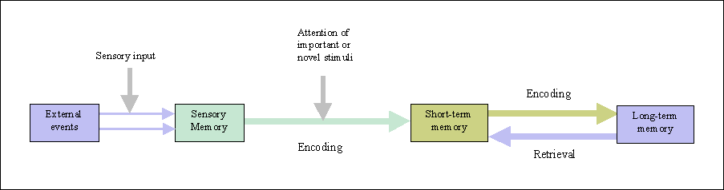
Contd..
Vast amounts of information is stored in long-term memory. And from our memory store we can retrieve information into an active working memory, part of which is displayed on our mental screen as short-term memory
Just as a computers screen-saver program blanks the screen after a period of inactivity, activated human memories rapidly decay unless kept active

Slide 11
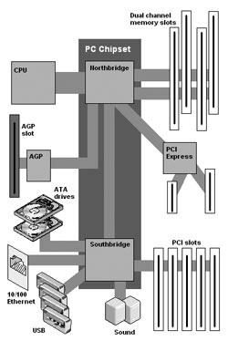
Memory Semiconductor-based integrated circuit
All actual computing starts with the the CPU (Central Processing Unit).
The chipset supports the CPU and contains several controllers that control how information travels between the CPU and other components in the PC.
The memory controller is part of the chipset and establishes the information flow between memory and the CPU.
A bus is a data path that consists of parallel wires and connects the CPU, memory and other devices. The bus architecture determines how much and how fast data can move around the motherboard.
The memory bus goes from the memory controller to the computer's memory sockets. Newer systems have a frontside bus (FSB) from the CPU to main memory and a backside bus (BSB) from the memory controller to L2 cache.
Notes:
In order to enable computers to work faster, there are several types of memory available today. Within a single computer there is no longer just one type of memory. Because the types of memory relate to speed, it is important to understand the differences when comparing the components of a computer. So get your memory ready as the following will explain what all those crazy abbreviations mean.
Many people assume that the speed of the processor is the speed of the computer. Most of the time, the system bus and other components run at different speeds. Because all information processed by the CPU is written or read from memory, the performance of a system is dramatically affected by how fast information can travel between the CPU and memory. Therefore, faster memory technology contributes greatly to the overall system performance.
Cache memory is a relatively small amount (normally less than 1 MB) of high speed memory and resides very close to the CPU. It is designed to supply the CPU with the most frequently requested data. It takes a fraction of the time, compared to normal memory, to access cache memory.
The concept is that 20% of the time, what is needed is in cache. The cache memory tracks instructions, putting the most frequent used instruction at the top of the list. Once the cache is full, the lowest need is dropped.
Today, most cache memory is incorporated in the CPU. It can also be located just outside of the CPU. Cache that is closest to the CPU is labeled Level 1, the next closest Lever 2, etc.
Interleaving is a process in which the CPU alternates between two or more memory banks. Every time the CPU addresses a memory bank, the bank needs about one clock cycle to reset. The CPU can save processing time by addressing a second bank while the first bank is resetting.

Slide 12
Role of Memory during Boot-up
When the computer is turns on
The computer loads data from read-only memory (ROM) and performs a power-on self-test (POST) to make sure all the major components are functioning properly
As part of this test, the memory controller checks all of the memory addresses with a quick read/write operation to ensure that there are no errors in the memory chips. Read/write means that data is written to a bit and then read from that bit
The computer loads the basic input/output system (BIOS) from ROM.\
The BIOS provides the most basic information about storage devices, boot sequence, security, Plug and Play (auto device recognition) capability and a few other items
The computer loads the operating system (OS) from the hard drive into the system's RAM

Slide 13
contd…
Generally, the critical parts of the operating system are maintained in RAM as long as the computer is on. This allows the CPU to have immediate access to the operating system, which enhances the performance and functionality of the overall system.
When you open an application, it is loaded into RAM. To conserve RAM usage, many applications load only the essential parts of the program initially and then load other pieces as needed
After an application is loaded, any files that are opened for use in that application are loaded into RAM
When you save a file and close the application, the file is written to the specified storage device, and then it and the application are purged from RAM

Slide 14
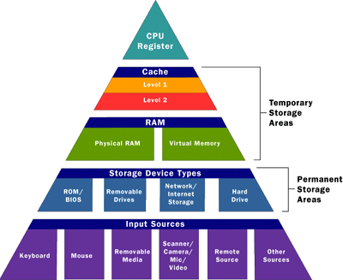
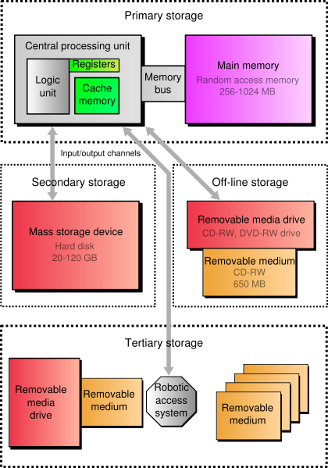
Memory Semiconductor-based integrated circuit

Slide 15
Memory Structure
Memory
Non Volatile
ROM
PROM
EPROM
EEPROM
FLASH
NOR
NAND
Hard-Disk, CD, DVD, Floppy Disk, Magnetic Tape, USB Flash memory, SD Card
Volatile
RAM
Static
Dynamic
Notes:
PROM
EPROM
EEPROM

Slide 16
Summary
Memory is the ability of the brain to store, retain, and subsequently recall information
There are several ways of classifying memories, based on duration, nature and retrieval of information
A computers capacity is steadily increasing with the more powerful ones being able to store hundreds of millions of bytes of information
The speed at which a computer is able to retrieve information is measured in milliseconds
Computer stores everything verbatim and is able to recall anything within milliseconds without loosing any information

